Slide 1
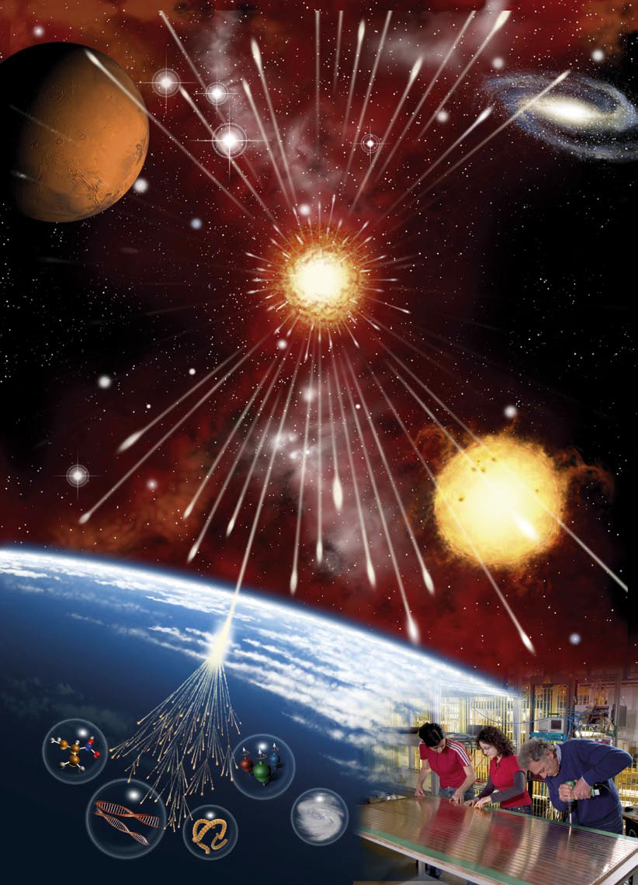
PROGETTO EEE (Extreme Energy Events)

Slide 2
Last measurement of the distances between schools gave following results:
G.Ferraris – A.Volta 1.41 km
A.Volta – M.D’Azeglio 1.15 km
G.Ferraris – M.D’Azeglio 1.07 km

Slide 3
Liceo A.Volta
N
207°

Slide 4
Liceo G.Ferraris
N
27°

Slide 5
Liceo M.D’Azeglio
N
297°

Slide 6
Liceo A.Volta
The detector in liceo A.Volta has been
mounted in September of 2007.
In May of 2008 we have rebuild the
telescope: decreased the distance
between chambers from 80 cm to
50 cm; changed trigger cables and
screened the signal cables.
As result we have decreased very seriously
the level of noise and increased common
efficiency of the system.
The experience which we took in the liceo
A.Volta we applied in other schools.

Slide 7
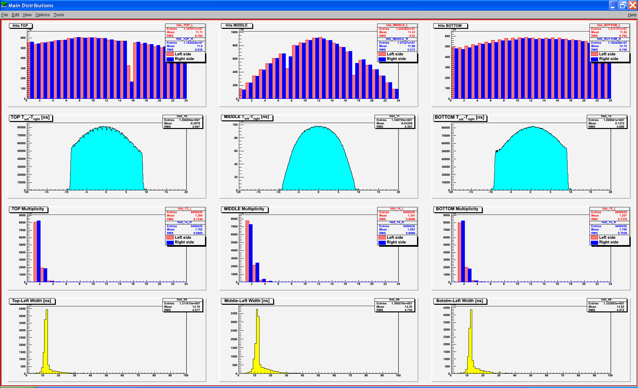
The data of the telescope are looking very well, we just have 3 missing channels here:

Slide 8
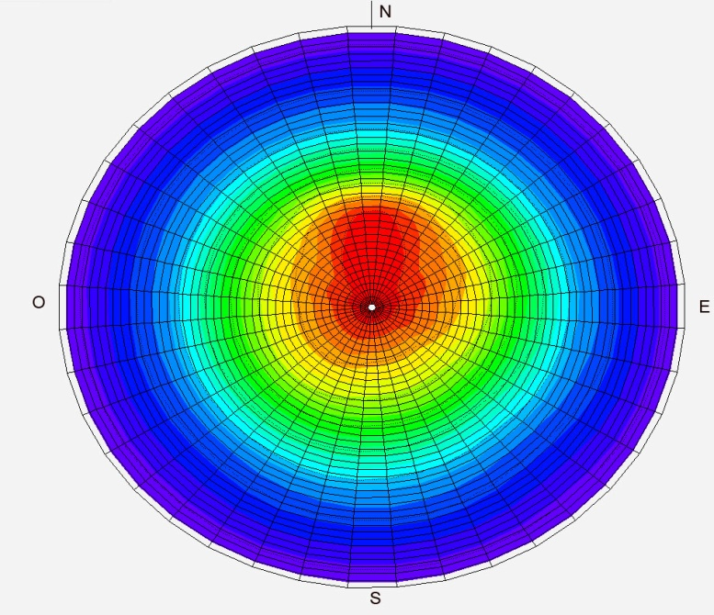
Angular distributions of the cosmic rays.

Slide 9
Hit distributions

Slide 10
Liceo G.Ferraris
Installation of the telescope in the G.Ferraris lyceum was completed in May of 2008.

Slide 11
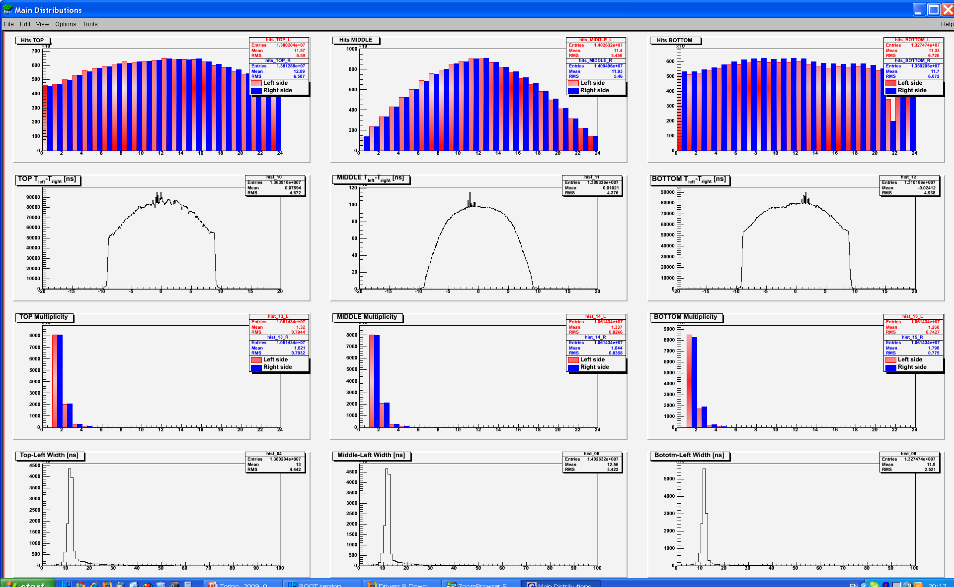
This telescope has best parameters. There is small noise
on the central part of chambers and only 1 missing channel.

Slide 12
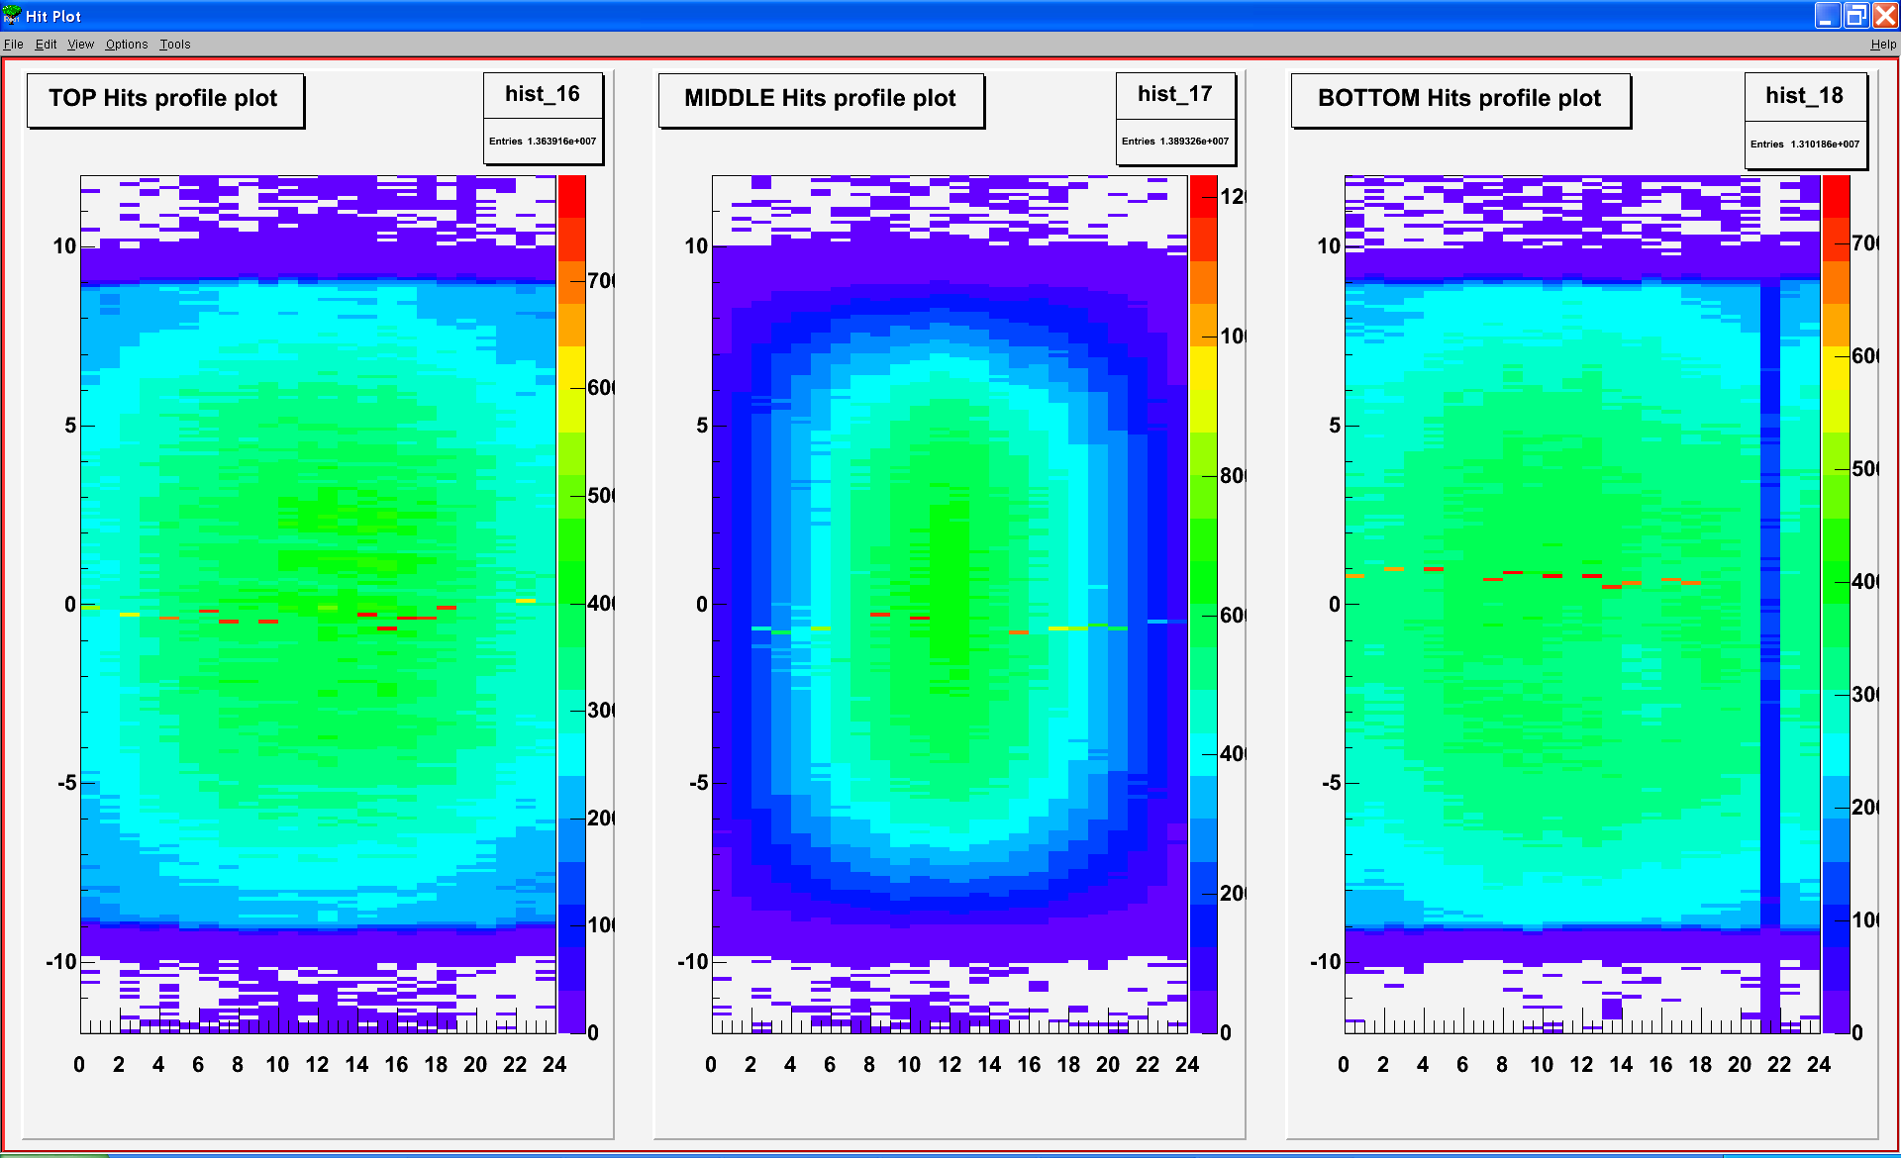
Hit distributions

Slide 13
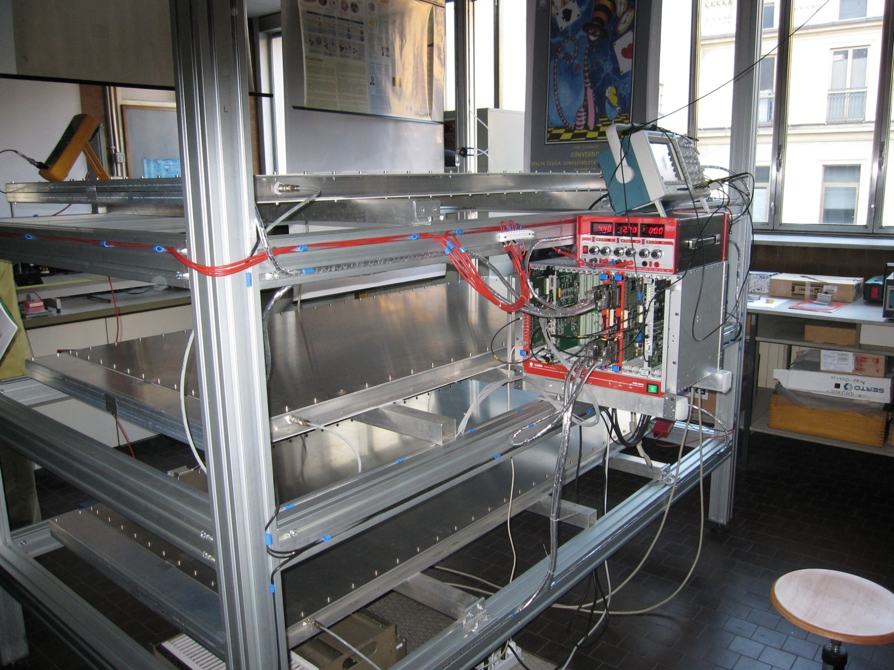
The telescope in liceo M.D’Azeglio has been mounted in September 2008

Slide 14
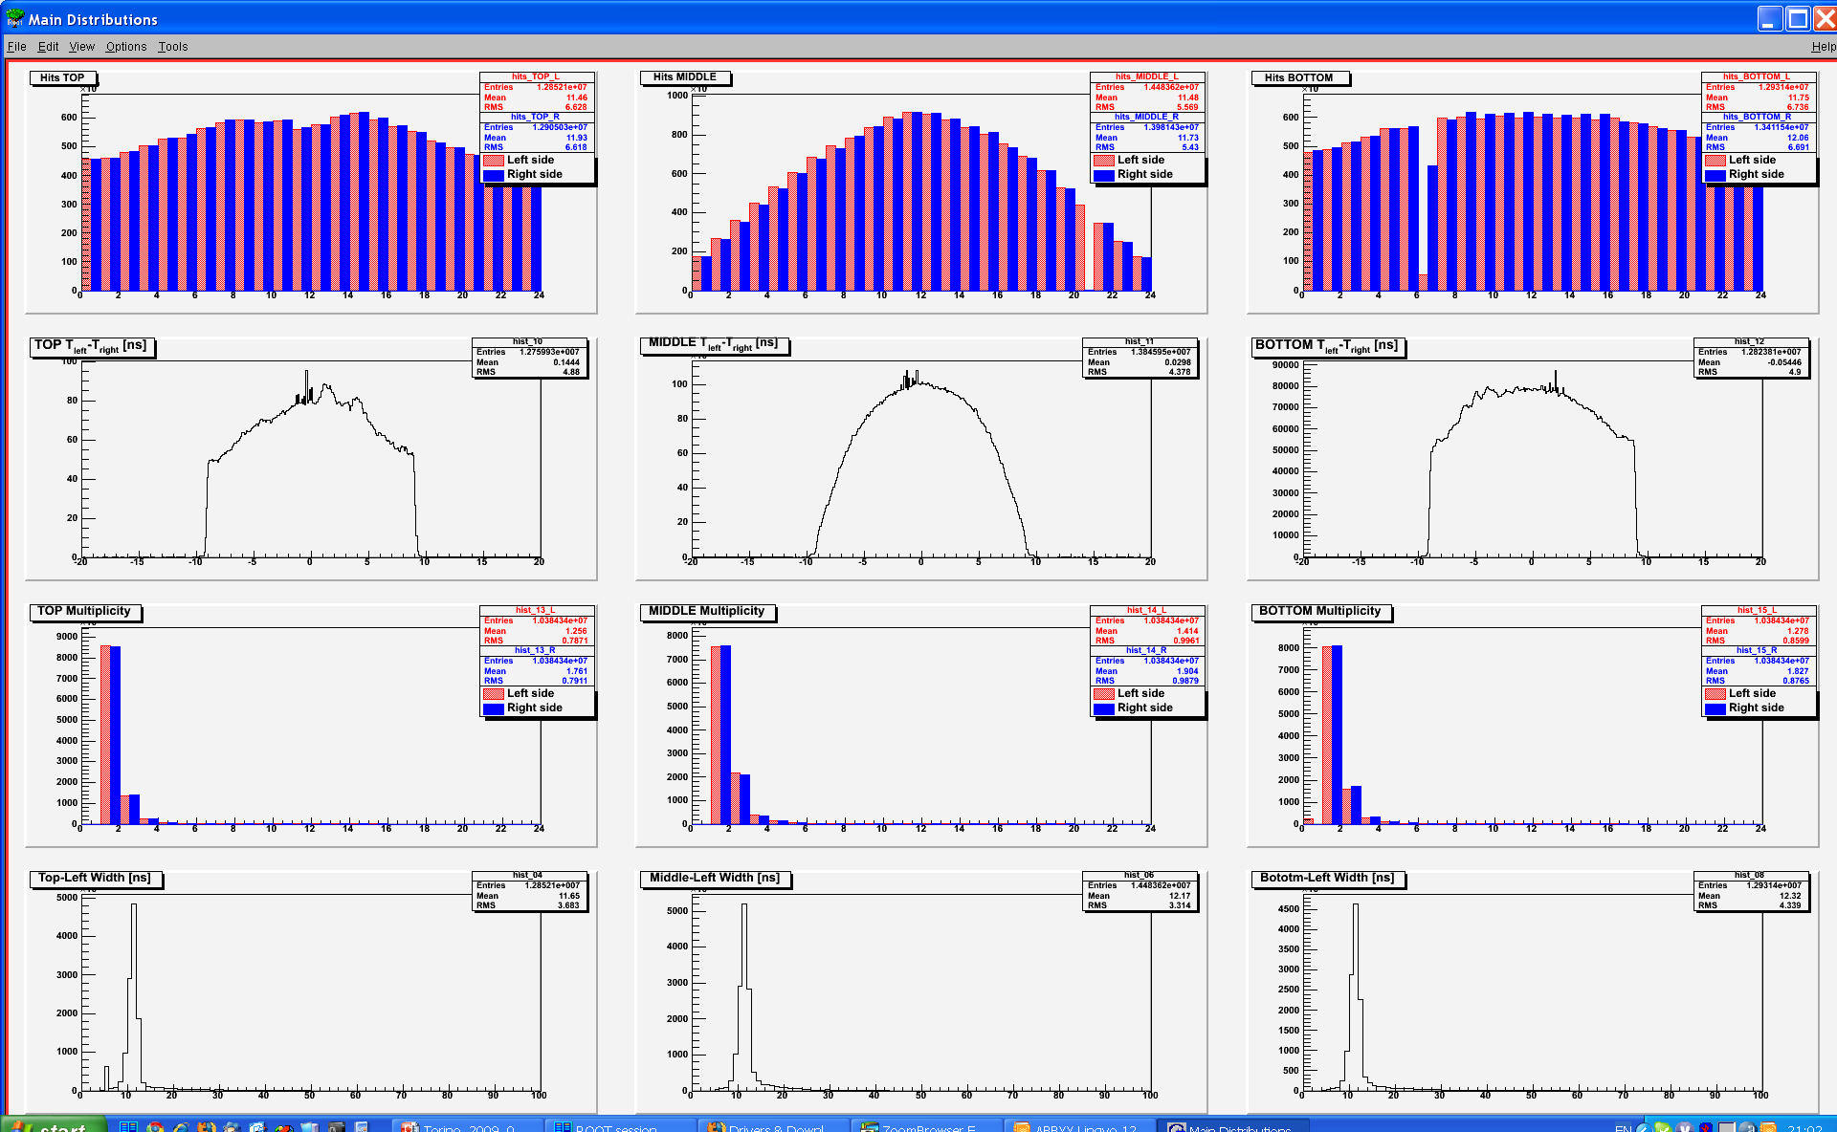
This telescope has one missing channel on bottom chamber and quite noisy
top chamber.

Slide 15
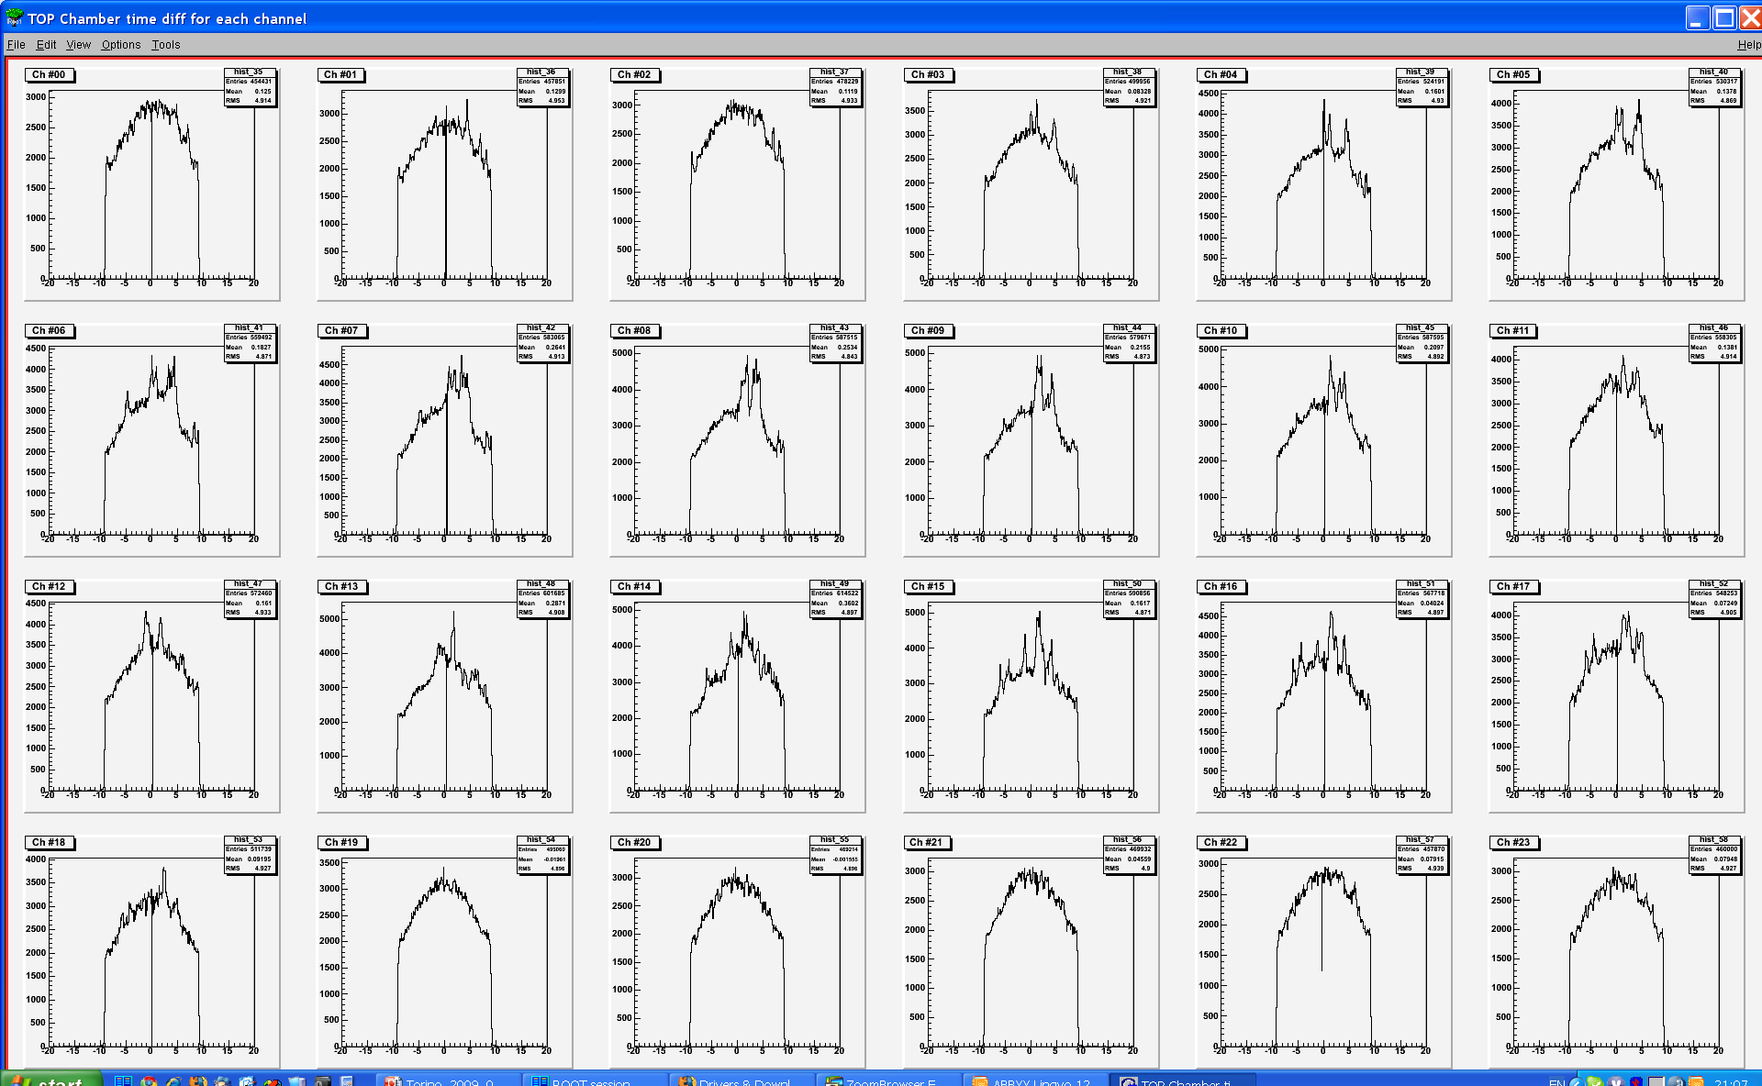
Additional investigation of the noising chamber shows that some strips of the
chamber are working well, but some of them have the “hot” spots.

Slide 16
EEE-Torino data analysis:
During September-December of 2008 we have got about 180 GB of data.
These data content about 4.5 millions seconds (52 days in total) of three telescopes operating time.
Preliminary analysis of the data gave us 14 triple coincidence candidates.
Unfortunately, background is so big that we cannot separate casual and real coincidences yet.

Slide 17
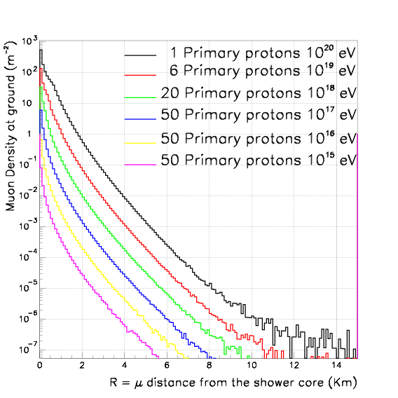
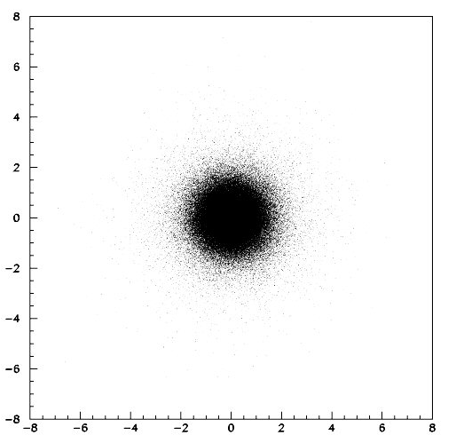
Muon lateral distribution
Muon density at the sea level (m⁻²)
R
R = distance to the shower core (Km)
Notes:
При помощи подобных программ, мы можем теоретически посчитать распределение вторичных частиц в ливне в зависимости от энергии начальной частицы и рассчитать зависимость размера «пятна» от высоты.

Slide 18
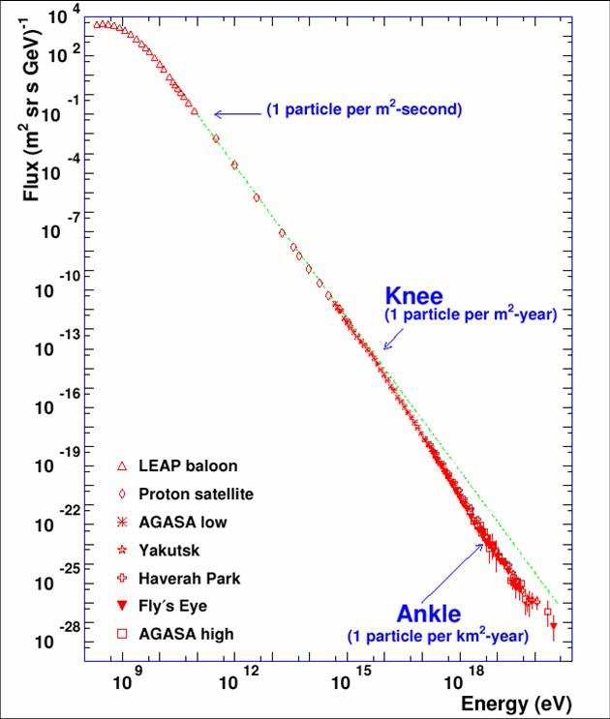
Notes:
Количество космических частиц в единицу площади за единицу времени в зависимости от их энергии.

Slide 19
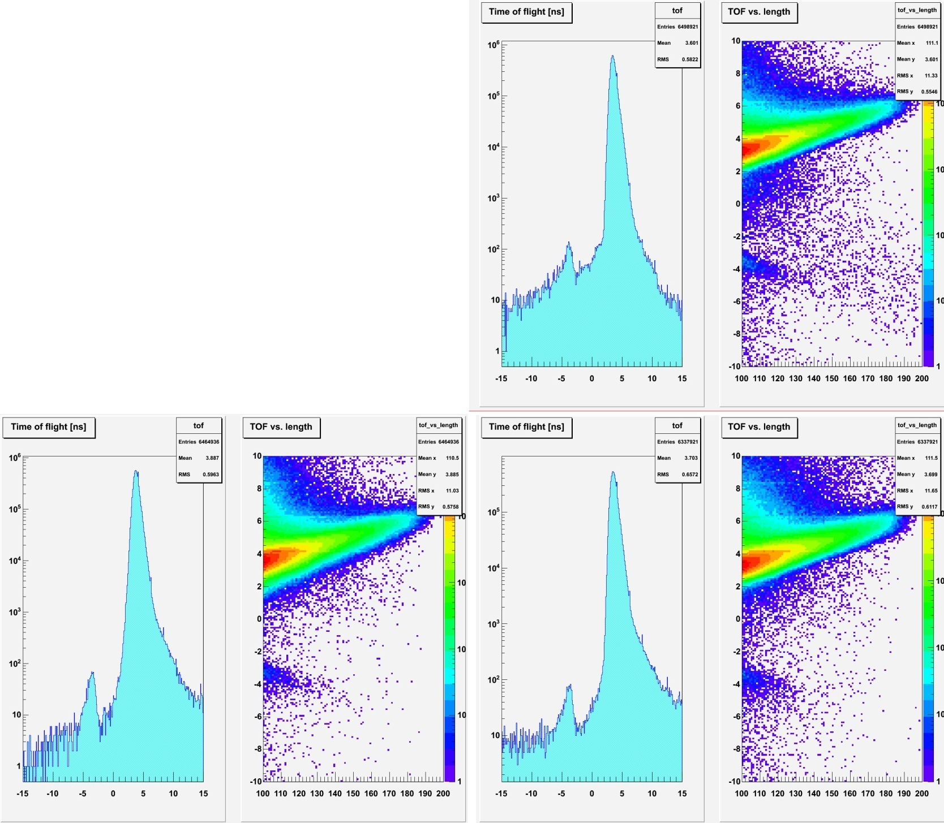
Time of flight analysis of tracks gave us very interesting results:
We are able to see very small number of the high energy particles with reverse direction.
This effect is not so clear for me.
Most probably these particles just reflected from the earth surface.

